Slide 2
Class 1
Danger and Opportunity

Slide 3
Danger
Opportunity

Slide 4
CONFLICT
Conflict is an Opportunity for us to GROW
Conflict is an Opportunity for us to become PEACEMAKERS

Slide 5
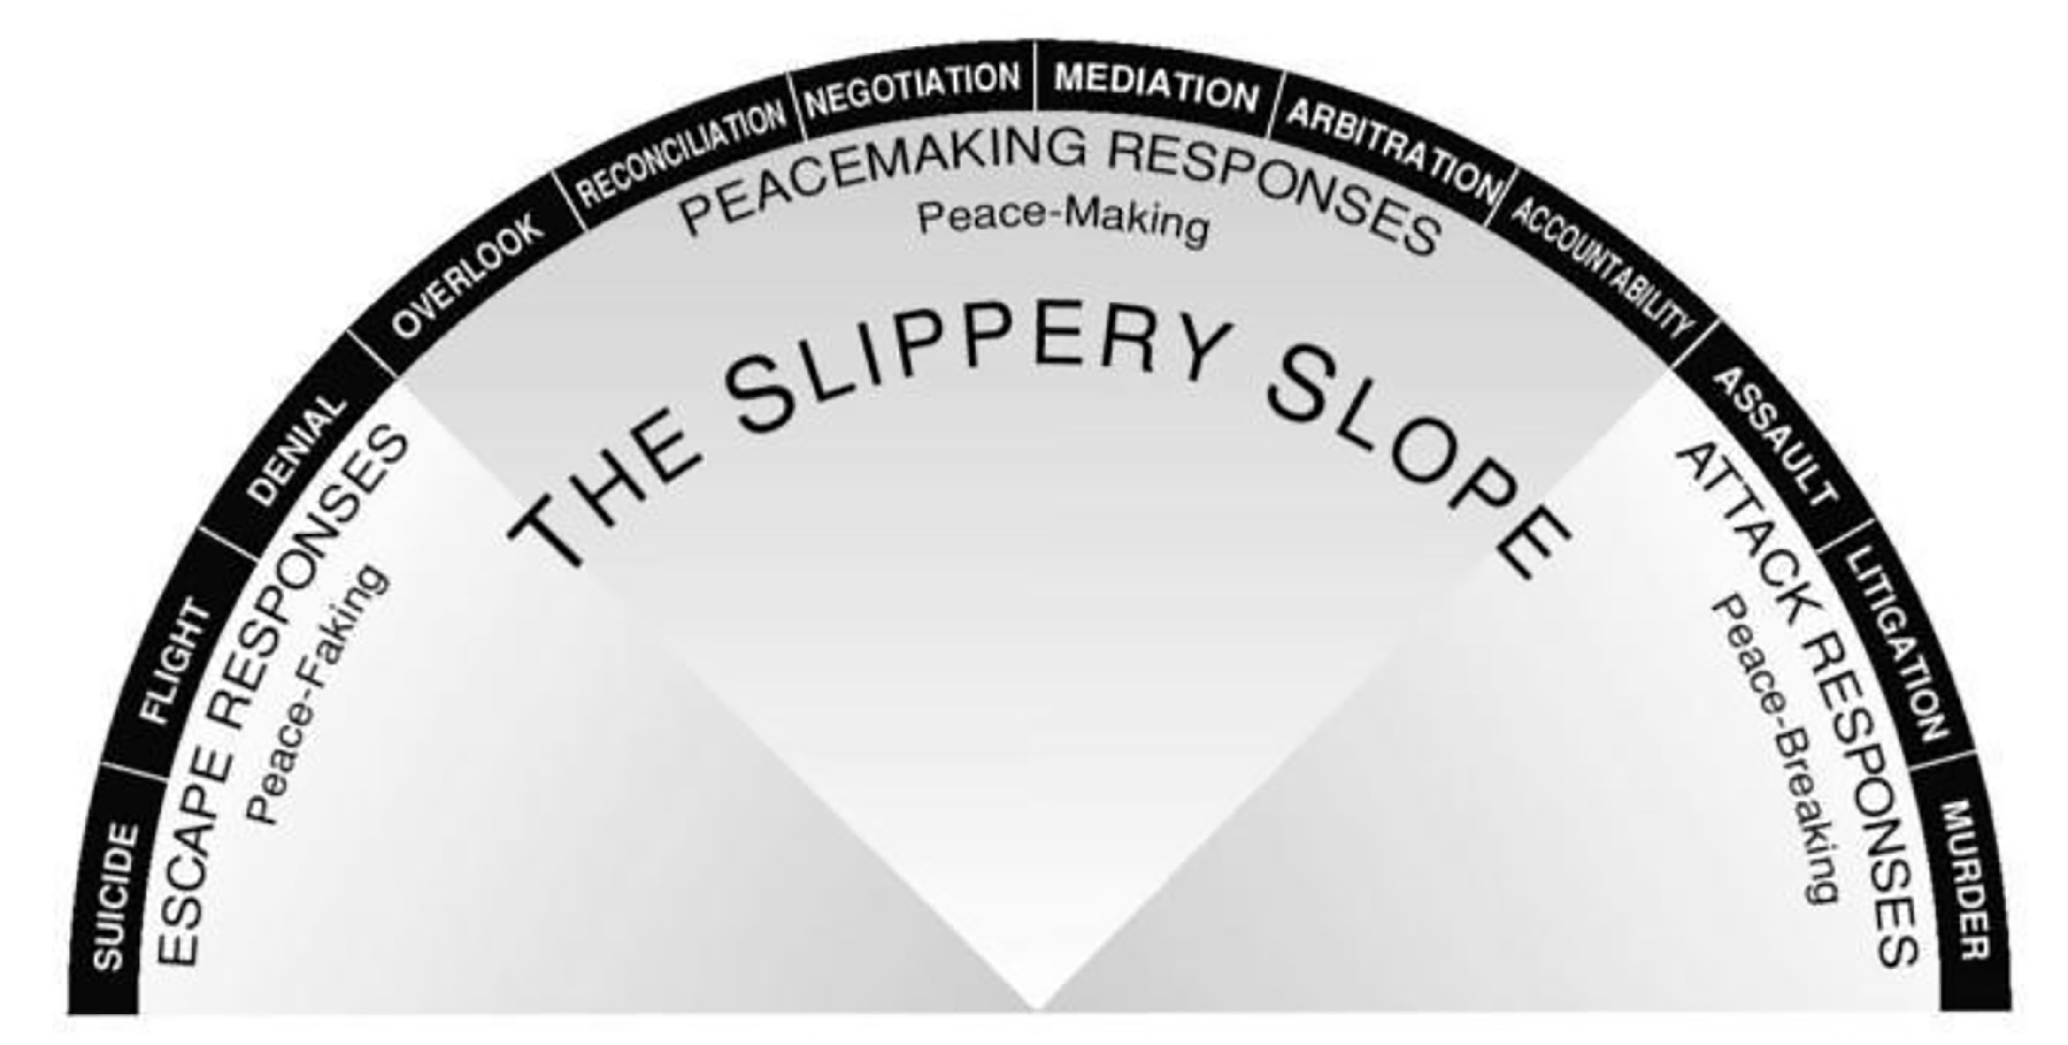
Peace Making
Peace
Faking
Peace
Breaking

Slide 6
To Begin
PRAY for help to Resist your Natural Inclinations
PRAY for help to Develop the Love of Jesus

Slide 7
Peace Faking
Denial
Genesis 6:6-8
6) Then Sarai dealt harshly with her, and she fled from her.
8) And he said, “Hagar, servant of Sarai, where have you come from and where are you going?” She said, “I am fleeing from my mistress Sarai.”
Genesis 6:1-6
1) Now Sarai, Abram’s wife, had borne him no children. She had a female Egyptian servant whose name was Hagar.
6) But Abram said to Sarai, “Behold, your servant is in your power; do to her as you please.”
Flight
Suicide

Slide 8
Peace Breaking
Acts 6:8-14
8) And Stephen, full of grace and power, was doing great wonders and signs among the people.
12) And they stirred up the people and the elders and the scribes, and they came upon him and seized him and brought him before the council
Matthew 5:21-22
21) “You have heard that it was said to those of old, ‘You shall not murder; and whoever murders will be liable to judgment.’
22) But I say to you that everyone who is angry with his brother will be liable to judgment; whoever insults his brother will be liable to the council
Assault
Litigation
Murder

Slide 9
Conflict
Conflict is is a difference in opinion or purpose that frustrates someone's goals or
desires

Slide 10
Conflict
1) Misunderstandings
Acts 15:36-39
37) Now Barnabas wanted to take with them John called Mark.
38) But Paul thought best not to take with them one who had withdrawn from them in Pamphylia and had not gone with them to the work.
39) And there arose a sharp disagreement, so that they separated from each other. Barnabas took Mark with him and sailed away to Cyprus
James 4:1-3
1) What causes quarrels and what causes fights among you? Is it not this, that your passions are at war within you?
2) You desire and do not have, so you murder. You covet and cannot obtain, so you fight and quarrel. You do not have, because you do not ask.
3) You ask and do not receive, because you ask wrongly, to spend it on your passions.
2) Differences
3) Competition
4) Sin

Slide 11
Conflict
Conflict
is NOT
always
Sinful
1st Corinthians 12:21-27
24) But God has so composed the body, giving greater honor to the part that lacked it,
25) that there may be no division in the body, but
that the members may have the same care for one another.

Slide 12
Although we should seek
Unity in our relationships,
we should not
demand Uniformity

Slide 13
1st Corinthians 10:31-33
31) So, whether you eat or drink, or whatever you do, do all to
the glory of God.
32) Give no offense to Jews or to Greeks or to the church of God,
33) just as I try to please everyone in everything I do, not seeking my own advantage, but that of many, that they may be saved.

Slide 14
Resolution
1) Glorify God
2) Get the Log out of Your Own Eye
3) Gently Restore
4) Go and Be Reconciled

Slide 15
Peace
1) God is Peace
1st Corinthians 13:11
11) Finally, brothers, rejoice. Aim for restoration, comfort one another, agree with one another, live in peace; and the God of love and peace will be with you.
Psalm 34:14
14) Turn away from evil and do good; seek peace and pursue it.
Numbers 6:24-26
24) The LORD bless you and keep you;
25) the LORD make his face to shine upon you and be gracious to you;
26) the LORD lift up his countenance upon you and give you peace.
2) God Blesses Us With Peace
3) God Commands us to Pursue Peace

Slide 16
Peace
Peace with
GOD
does not
come automatically
Romans 5:1-2
1) Therefore, since we have been justified by faith, we have peace with God through our Lord Jesus Christ.
2) Through him we have also obtained access by faith into this grace in which we stand, and we rejoice in hope of the glory of God.
Ephesians 2:8-9
8) For by grace you have been saved through faith. And this is not your own doing; it is the gift of God,
9) not a result of works, so that no one may boast.

Slide 17
Peace
Peace with
GOD
does not
come automatically
Peace with OTHERS
is not the absence of conflict
Peace with YOURSELF alludes
most
people

Slide 18
Peace
Isaiah 32:17
17) And the effect of righteousness will be peace, and the
result of righteousness, quietness and trust forever.

Slide 19
Peace
Enemy of
Ephesians 4:4-7
4) There is one body and one Spirit—just as you were called to the one hope that belongs to your call—
5) one Lord, one faith, one baptism,
6) one God and Father of all, who is over all and through all and in all.
7) But grace was given to each one of us according to the measure of Christ’s gift.
Ephesians 4:11-13
11) And he gave the apostles, the prophets, the evangelists, the shepherds and teachers,
12) to equip the saints for the work of ministry, for building up the body of Christ,
13) until we all attain to the unity of the faith and of the knowledge of the Son of God, to mature manhood, to the measure of the stature of the fullness of Christ
Ephesians 4:8-10
8) Therefore it says, “When he ascended on high he led a host of captives, and he gave gifts to men.”
9) (In saying, “He ascended,” what does it mean but that he had also descended into the lower regions, the earth?
10) He who descended is the one who also ascended far above all the heavens, that he might fill all things.)
Ephesians 4:1-3
1) I therefore, a prisoner for the Lord, urge you to walk in a manner worthy of the calling to which you have been called,
2) with all humility and gentleness, with patience, bearing with one another in love,
3) eager to maintain the unity of the Spirit in the bond of peace.

Slide 20
You are called to be
UNITED as ONE in the Love of Jesus Christ with people who
COULDN’T BE ANY
DIFFERENT FROM YOU

Slide 21
Ephesians 4:32
32) Be kind to one another, tenderhearted, forgiving one another, as God in Christ forgave you

